Slide 1
Unmanaged Internet Protocol
Taming the Edge Network Management Crisis
Bryan Ford
Massachusetts Institute of Technology
2004
July 23, 2009

Slide 2
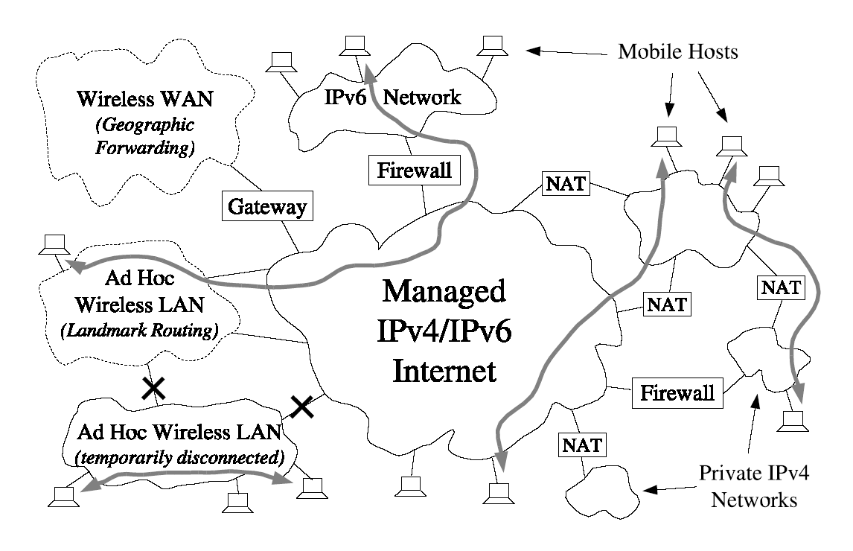
Overview
Environment
  Large Scale Edge Networks
Motivation & Problem
  The Edge Network Management Crisis
  IP Networks Require Management
  Ad-Hoc Networks Do Not Scale
Proposed Scheme
  UIP(Unmanaged Internet Protocol)
    Scalable identity-based routing.

Slide 3
Motivation
The Edge Network Management Crisis
  The protocols underlying the Internet were designed by technically savvy individuals who understand how networks work
  but often do not understand how non-technical users work.
  Ex)
  Joe User is working at home on his laptop. He has remote shell and database access sessions open, through his WiFi home network, to his desktop PC and to a machine at his workplace.
  He moves with laptop to his friend Jim’s home and continue to works.
    Configure home NAT to assign fixed site-local IP address to his desktop and laptop PC s at home.
    Configure his NAT to open the appropriate external port for remote access and forward incoming connections on those ports to his desktop PC
    Register for a global DNS host name with a Dynamic DNS service provider
    Set up his desktop PC to update this DNS name periodically with the dynamic IP address his ISP assigns to his hoe NAT
    Set up Mobile IP so that his desktop PC at home will intercept packets destined for his laptop’s “home” IP address, and tunnel them to his laptop at its actual connection point
    Run daemons on his laptop and PDA that detect when no infrastructure-mode WiFi access point or DHCP service is available.
    => It is not easy to non-technical user.

Slide 4
Motivation(cont.)
  IP Networks Require Management
    Good Scalability and efficiency, but Bad usability.
    Hierarchical address assignment scheme using on current Internet Protocol makes edge networks brittle and difficult to manage.
      Whenever a node moves or its surrounding network is renumbered, the node’s IP address must change.
    These issue will persist even into a future Ipv6 world in which there are “enough” IP addresses for everyone and network address translators do not exist.
      Because current IP represents both Identity Information and Location information.
  Ad-Hoc Networks Do Not Scale
    Good self-management, but bad scalability.
    Classic distance-vector and link-state routing protocols require big overhead of storage and traffic.
      Every node to store and regularly exchange information about every other node in the network.

Slide 5
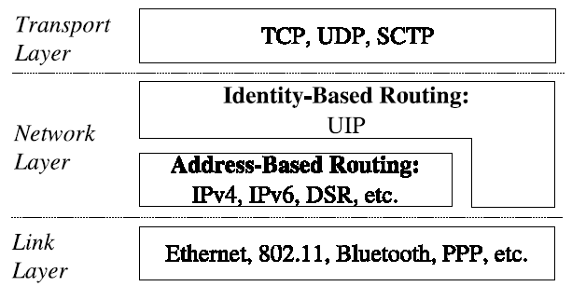
Proposed Scheme
  UIP(Unmanaged Internet Protocol)
    Provide self-managing not only on a local scale, but also on a global scale.
    Provide reliable ad-hoc routing within edge networks that are temporarily or permanently disconnected form the Internet.

Slide 6
Proposed Scheme(cont.)
  Node Identities
    Applications use self-certifying cryptographic identifiers that hash of the node’s public key.
    All connections between UIP nodes are privacy and integrity protected by default as in IPSEC.
    By using cryptographic identities,
      Globally unique UIP identifier at any time without reference to central authorities.
      A node’s identifier can be remains valid as long as desired.
      The node can retain its identity when it moves or the surrounding network topology change.
      A node can cryptographically prove ownership of an identifier using the associated private key, preventing an attacker from stealing its identity.
      Multiple identities simultaneously.
      Independent on centralized public key infrastructure.

Slide 7
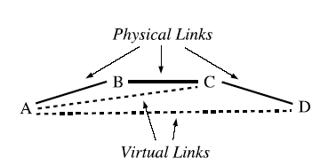
Proposed Scheme(cont.)
  Routing
    Approaches to Identity-Based Routing
      Less important to find best possible route, but more important to be scale, robust, and fully self-managing
    Converting DHTs into Routing Algorithms
      DHT provide connectivity between all participants.
      Experimenting with a scalable routing protocol derived from Kademlia distributed hash table(DHT)
      O(longN) storage and maintenance overhead per node and average stretch of 2.
      Extends Kademlia-Virtual Links
        By Using virtual links AC, node D can communicate with A without know detail path between A and C.
    Stretch: Route Efficiency Measuring Metric
    Length_{Find}/Length_{Best}

